Slide 1
UE20CS971 - Project Phase – 2
End Semester Assessment
Project Title : Differential Analysis of Breast tumour using 2D Base-UNet and Residual UNet on Ultrasound images(BUSI)
Project Guide : Dr. Narayana Darapaneni
: Anwesh Reddy Paduri

Slide 2
Agenda
Problem Statement
Introduction
Abstract and Scope
Dataset- Breast ultrasound images
Literature Survey
Proposed Methodology / Approach
Approach Constraints, Assumptions & Dependencies
Applications
Project Progress
References

Slide 3
Problem Statement
Problem statement:
Differential analysis of breast tumour using 2D U-Net and Residual U-Net on ultrasound (BUSI)images.
Research objective:
Classification of Breast tumour.
Differential Analysis by determining the growth rate of Breast tumour.
Differential Analysis of Breast Tumour by checking its status(Progressive,Regressive,New Tumour)
Determine the direction of progression or regression of Breast tumour.
Evaluation of the Model performance (Base UNet and Residual UNet)

Slide 4
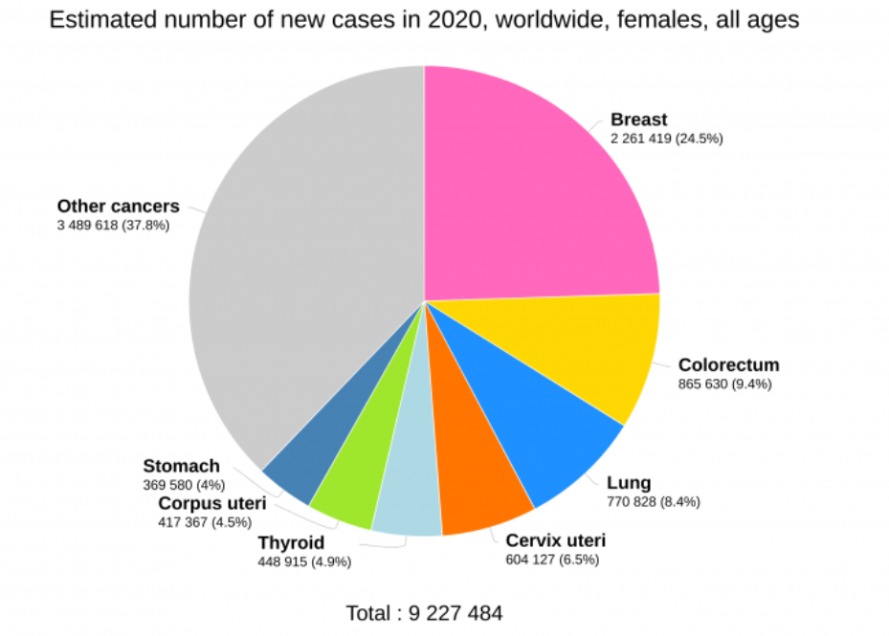
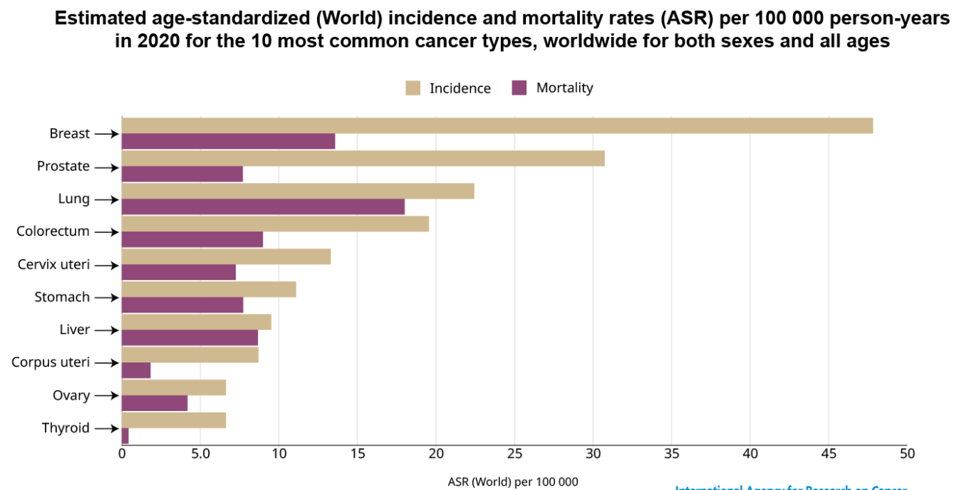
Introduction
Detect breast cancer in a patient using UNet architecture & its variants
As per the statistics 2.26M breast cancers patients were diagnosed in 2020
Breast cancer remains the most commonly occurring cancer in women. Breast cancer detection, treatment, and prevention are prominent issues in public health and medical practice. 25% to 30% of women with invasive breast cancer will die of their disease.
95% of breast cancers are carcinomas, that arise from breast epithelial elements.
Mortality rates are highest in the very young (< 35yrs) and in the very old (>75yrs).
Breast cancer incidence is highest in North America and Northern Europe and lowest in Asia and Africa. Getting Mammography done beginning at age 40 is the current recommendation for women with no risk factors.

Slide 5
Abstract and Scope
Abstract: Breast cancer is the leading cause of death among the women. The main objective of this paper is to do differential analysis of breast tumour using 2D U-Net and Residual U-Net on ultrasound (BUSI) images. For the differential analysis of tumour, we are assuming the BUSI scans as the scans of the same patients taken monthly. By analysing the differences in the size of the tumour, the classification of tumour is determined. If there is increase in the size of the tumour, then its classified as Malignant otherwise Benign. Similarly, by calculating the differences in the size of the tumour which are classified as malignant for the successive scans assuming to be taken monthly, growth rate of the tumour can be determined. By analysing the area of the tumour, we can also check if any new occurrence of tumour is happening in the body. Using the rectangle box approach for determining the size of tumour, by analysing the changes in the coordinates of the rectangle, direction of progression of tumour is also determined. By comparing the value of dice coefficient and Area ratio we are determining weather the Tumour is progressing or regressing or its Benign.
Scope: The scope of this system is to check how the tumours is progressing inside body and help clinicians to take correct decision and the course of treatment.

Slide 6
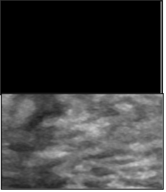
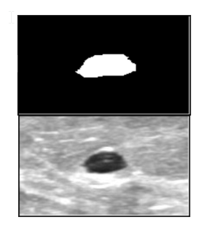
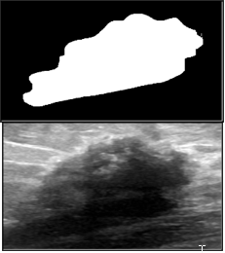
Normal Benign Malignant
Dataset- Breast ultrasound images
Age group between 25 and 75 years
600 female patients
780 images with an average Image Size of 500 x 500 Pixels

Slide 7
Literature Survey
Cancer is a major death causing disease reported in the world
There has been shift in research field to detect the cancer in early stages with the advent of AI & ML
There are researches carried out in the Image and Vision computing to detect cancer using the scanned images
The latest researches were carried out using Convolution Neural Network like RCNN, YOLO
The Base UNET architecture was invented to detect the tumor in brain in the year 2015
The UNET architecture was invented to contribute to the biomedical image processing
The research is carried out to detect breast cancer using the MRI scanning dataset
Knowledge of tumour growth is important in the classification of tumour type ,planning and evaluation of screening programs, clinical trials and making decisions about patient treatment.
The aim of the present study is to utilize U-Net and Residual U-Net model to determine the differences in the tumour size of two segmented mask images for tumour growth rate estimation and also check for occurrence of any new tumour in the same area where first tumour was detected

Slide 8
Literature Survey Continued..
Differential analysis of tumours is important in the classification of tumours type, planning and evaluation of screening programs, clinical trials and making decisions about patient treatment. Differential analysis of tumours has never taken up as research till now. Mostly all the studies are based on the medical laws, so this research will be the first paper on the differential analysis of tumour using Deep learning approach. In our literature survey we focus on below three points:
What is the value addition of our project
What are the challenges in doing differential analysis of breast tumour
What are the limitations using rectangle box approach using OpenCv library.

Slide 9
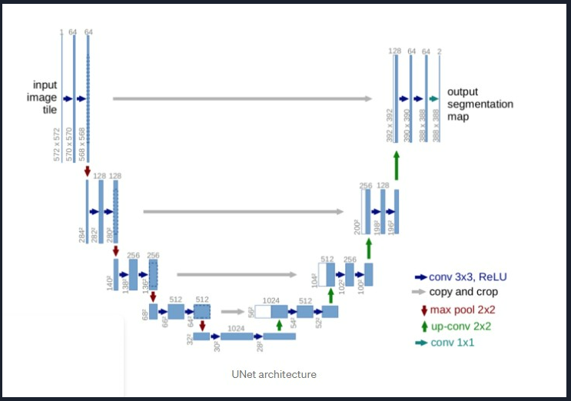
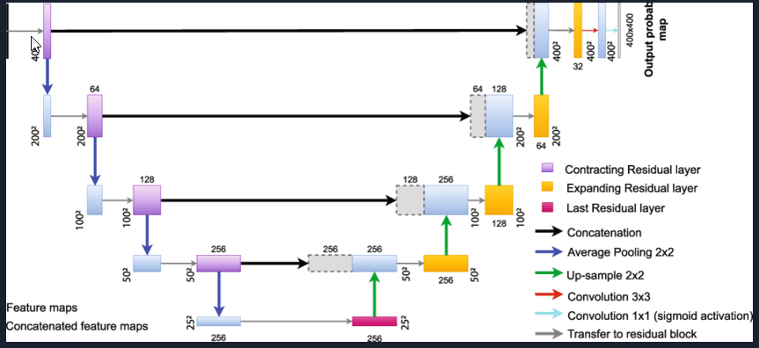
First Proposed Methodology / Approach
Base UNet
Segmented Mask Image Predicted by the model
BUSI Data Set
Residual UNet
Number of white Pixel of Predicted Mask Image Approach
Classification of Tumour
Differential Analysis of Tumour
Growth Rate of Tumour
Size Determination
Direction of Progression of Tumour
OpenCV Rectangular Box Approach
Comparison of size of Tumour Predicted by Base UNET and RESUNET

Slide 10
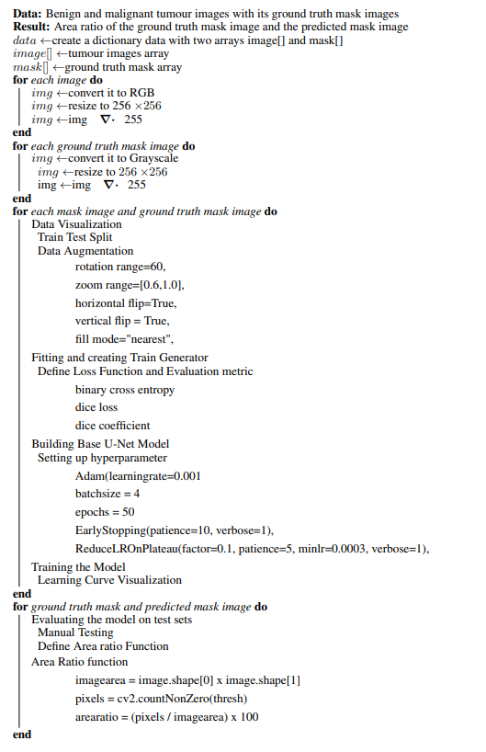
Algorithm1: Comparison of area ratio of ground truth mask image and the predicted mask image .

Slide 11
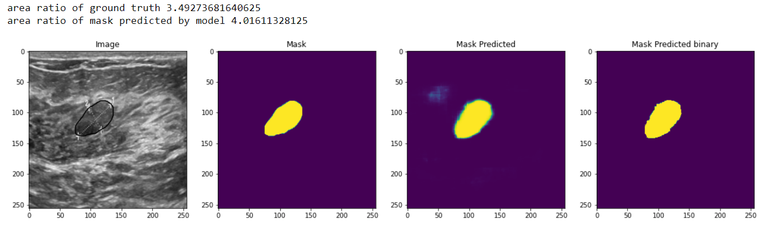
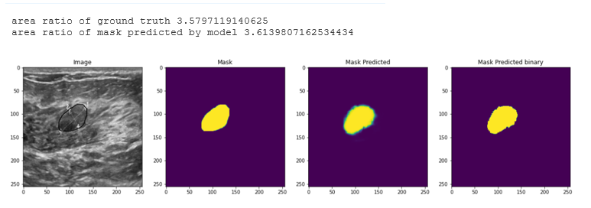
Outcome of Algorithm-1
1. Area ratio of ground truth mask image and predicted mask image
Base UNet
Residual UNet

Slide 12
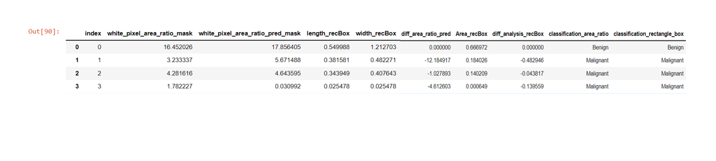
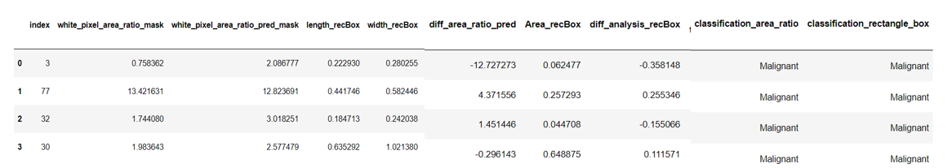
Outcome of Algorithm-1
2. Classification of Tumour
Base UNet
Residual UNet

Slide 13
Outcome of Algorithm-1
3. Comparison of performance of Two Models

Slide 14
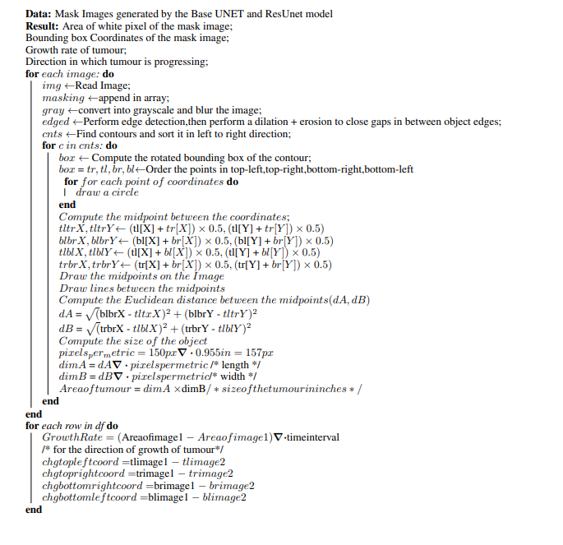
Algorithm 2 :To find the direction of progression of tumour and its growth rate

Slide 15
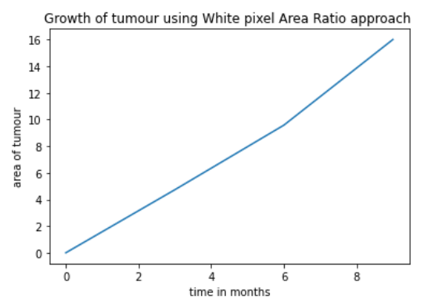
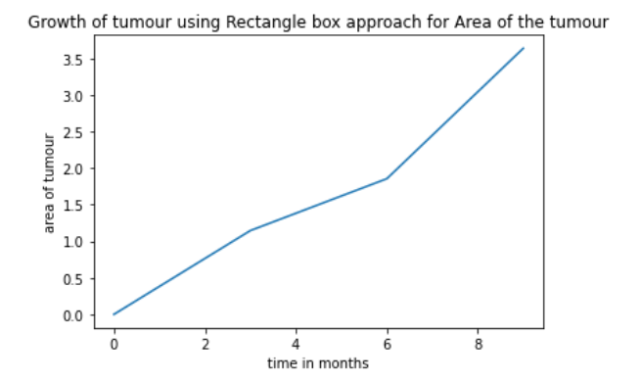
Outcome of Algorithm-2
1. Growth curve of tumour

Slide 16
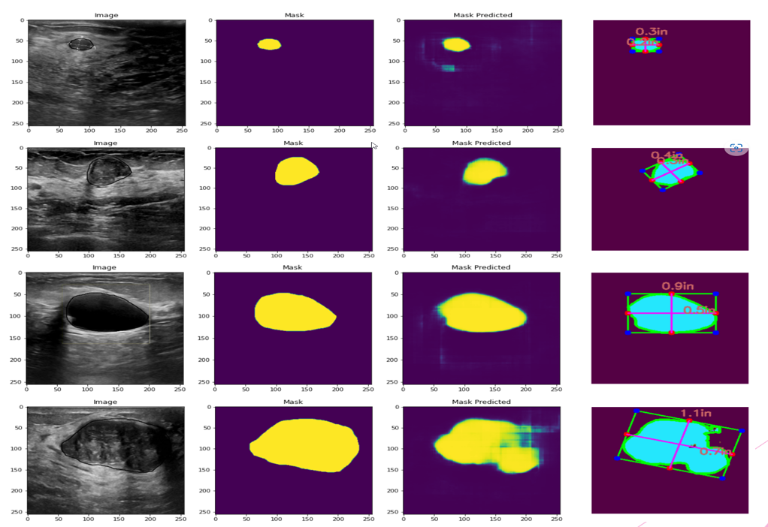
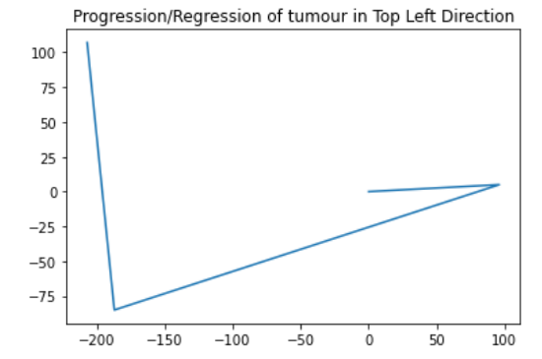
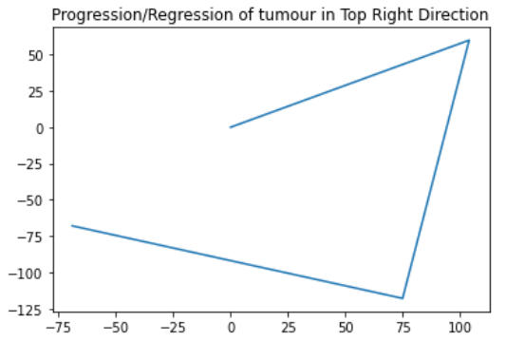
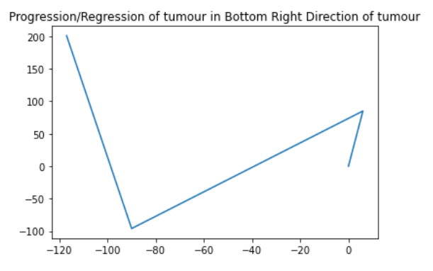
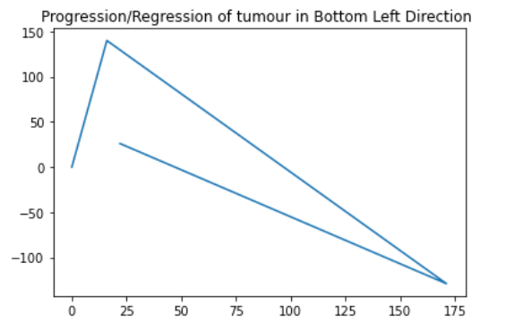
Outcome of Algorithm-2
2. Direction of progression or regression of tumour

Slide 17


Second Proposed Methodology / Approach
Base UNet
Segmented Mask Image Predicted by the model
BUSI Data Set
Residual UNet
Tumour is Benign
If
Diff_Area_ratio =0
If Dice Score=1
Yes
Yes
Calculate Dice Score= Dice coef(img1,img2)
No
Tumour is Regressing
If Diff_Area_ratio is +tive
If Dice Score=0
No
No
Yes
Tumour is Progressing
If Diff_Area_ratio is +tive
New Tumour has occurred(or first tumour )
Yes

Slide 18
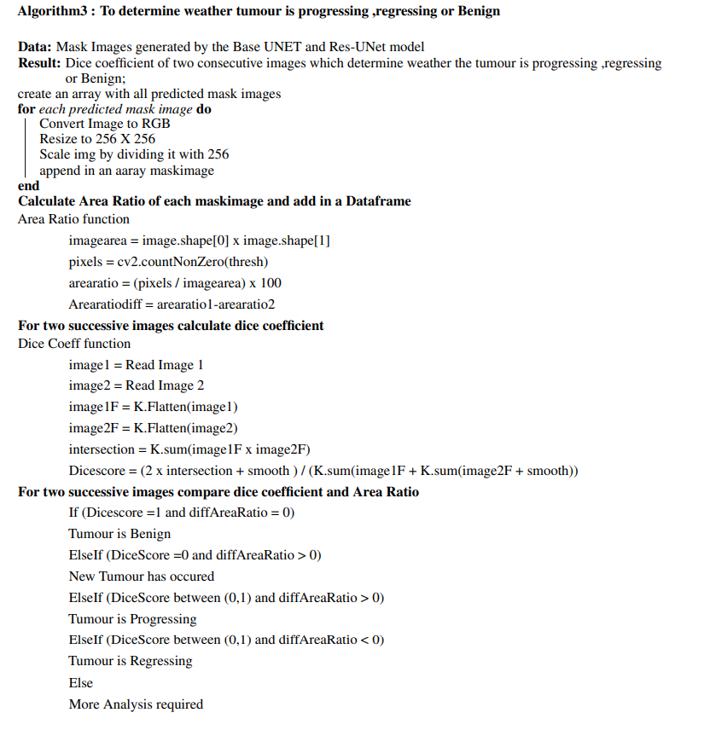
Algorithm 3: To determine Tumour status using Dice Coefficient and difference in White pixel Area Ratio of the two successive scans

Slide 19
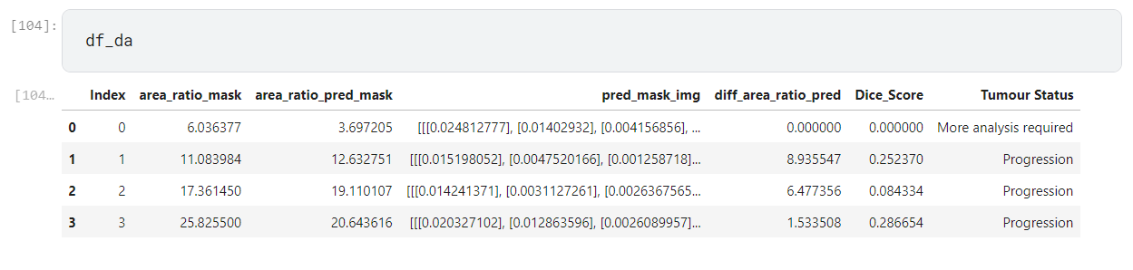
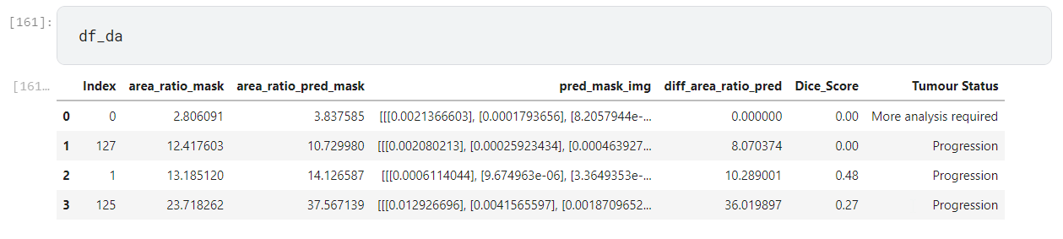
Outcome of Algorithm-3
1. Tumour Status
Result from Base UNet Model
Result from Residual UNet Model

Slide 20
Design Constraints, Assumptions & Dependencies
Assumption: For determining the size of tumour two approaches has been used here: White Pixel approach and Rectangle box approach using OpenCV library functions. In the rectangle box OpenCV approach we have taken a reference object as a scale for determining the length the width of the rectangle box surrounding the mask image. For our study as we don’t have a reference object inside in our segmented image, so we have taken a US quarter as our reference object which has a known width of 0.955 inches and its width computed as 150 pixels wide taken as a scale for the measurement of tumour size in inches.
Dependencies: This project is dependent on how well the UNET model segment and predict the mask of the tumour. We proposed to use Residual UNET model architecture as it gives the highest dice coefficient score with BUSI dataset. This project also dependent on the approaches used for the determination of size of tumour. The more accurate the size of tumour the more accurate the results of differential analysis will be.
Constraint: Gathering of information and dataset and its structurization in standardized format will be a challenging task for this project. The computational requirements will also increase with the increase of the size of real time dataset and with the complexity of model architecture. Augmentation of Image can further create complexity to the Algorithm.

Slide 21
Applications
Differential analysis of tumour can help in deciding the line of treatment for the patient.
It can also help in analysing how patient body is responding to a particular treatment.
Differential analysis when combine with pathological information can help in predicting the morphological information of tumour.
Differential analysis on the size and the location of tumour also helps in determining the stage of cancer.
This Model can also help inexperienced operators to avoid misdiagnoses.

Slide 22
Project Progress
Phase 1
1. Image segmentation of Breast tumours scans using Base UNET and Residual UNET model
Phase 2
1. Incorporate the rectangle box size determination code with the base code
2. Size determination of mask image of tumour predicted by Models
3. Comparison of two models base on the area ratio of the predicted mask images
4. Classification of the tumour
5. Growth rate of tumour
6. Direction of progression of tumours
2. Implementation of new approach :overlay of two images on one another and calculate its dice coefficient. If dice coefficient =1, then no change in tumour else check for progression or regression of tumour and occurrence of new tumour.

Slide 23
References
An Embedded Real-Time Object Detection and Measurement of its Size | IEEE Conference Publication | IEEE Xplore
Estimating tumor growth rates in vivo (nih.gov)
Breast cancer tumor growth estimated through mammography screening data (nih.gov)
Analysis of Tumor Growth Curves2 | JNCI: Journal of the National Cancer Institute | Oxford Academic (oup.com)
Calculate the area of the masks (in pixels) in grey scale images with python - Stack Overflow
Measuring size of objects in an image with OpenCV – PyImageSearch
2009.12894.pdf (arxiv.org)
Stepwise logistic regression analysis of tumor contour features for breast ultrasound diagnosis - ScienceDirect
Decelerating growth and human breast cancer (wiley.com)
Understanding Cancer Prognosis - NCI
Accuracy of tumor size measurement on shear wave elastography (SWE) (nih.gov)
Voxel size and gray level normalization of CT radiomic features in lung cancer | Scientific Reports (nature.com)
Finding size of the object in python (OpenCV)? - Stack Overflow
Contour Detection using OpenCV (Python/C++) (learnopencv.com)
Brain Tumor Detection and Localization - Analytics Vidhya

Slide 24
Thank You

